Slide 1
Inversion of control
Design principle
Notes:
https://www.tutorialsteacher.com/ioc/ioc-container
https://www.tutorialsteacher.com/ioc/dependency-injection
https://docs.simpleinjector.org/en/latest/quickstart.html

Slide 2

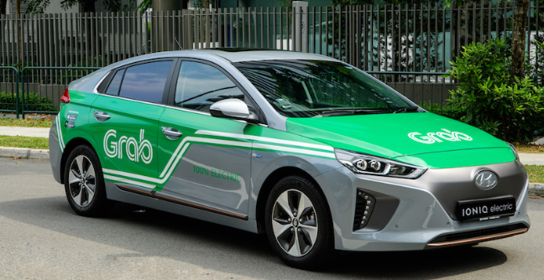
What is Inversion of control - IoC?
A design principle in software engineering
Dependencies of components is shifted to a container or framework
Example: Instead of driving yourself, hire a grab driver to drive for you

Slide 3
What is control?
Any additional responsibilities a class has other than its main responsibility
control over the flow of an application
control over the dependent object creation and binding (lifecycle management)

Slide 4
Why do we need IoC?
Loose coupling between components
Independent & easier to replace or modify
More modular, flexible, & easily maintainable code
Test driven development is impossible without IoC

Slide 5
Principles or pattern or framework?
Inversion of control
IoC
Dependency Inversion Principle
DIP
Principle
Dependency Injection
DI
Pattern
IoC Container
Framework

Slide 6
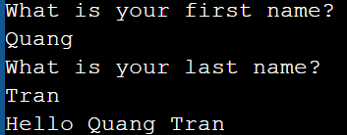
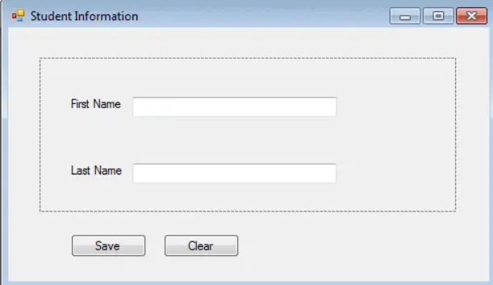
Example of IoC (1) - Flow of a Program
Console vs Event handling

Slide 7
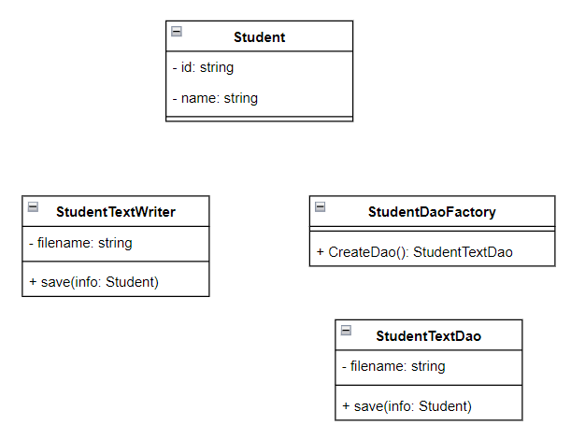
Example of (2) - Dependent Object Creation

Slide 8
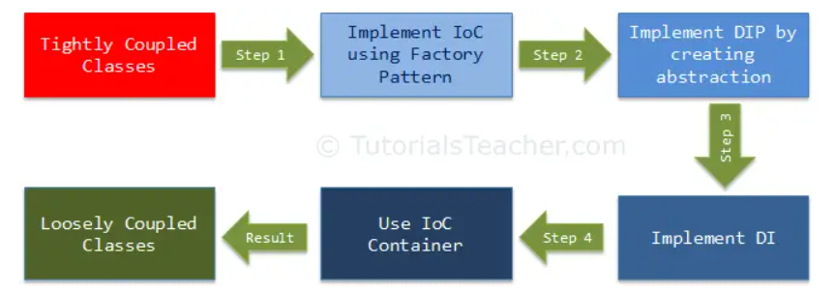
From tightly coupled to loosely coupled

Slide 9
Dependency inversion principle
High-level modules should not depend on low-level modules. Both should depend on the abstraction.
Abstractions should not depend on details. Details should depend on abstractions.

Slide 10
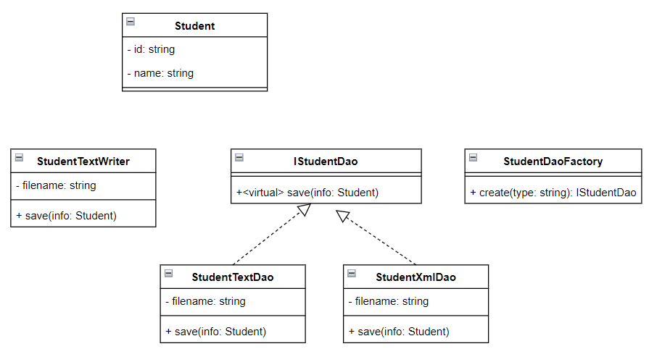
DIP example - Abstraction

Slide 11
Dependency Injection Pattern
Creation of dependent objects outside of a class
Provides those objects to a class through different ways
Constructor injection
Property injection
Method injection
Move the creation and binding of the dependent objects outside of the class that depends on them

Slide 12
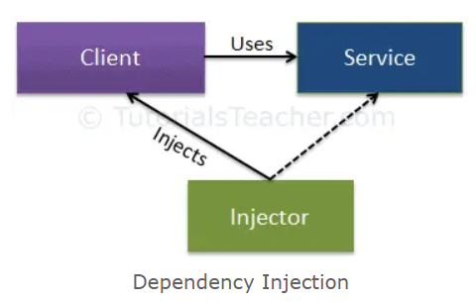
Components in DI pattern

Slide 13
IoC Container
Framework for
Implementing automatic dependency injection
Manages object creation and it's life-time
Injects dependencies to the class

Slide 14
IoC Container must support
Register
Lifestyle: Transient, Singleton, Scoped (thread / async / web request)
Resolve / GetInstance
Dispose

Slide 15
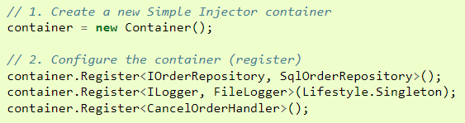
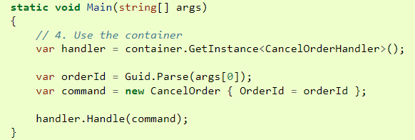
Sample usage (Simple Injector)

Slide 16
Open source or commercial containers
Unity
StructureMap
Castle Windsor
Ninject
Autofac
DryIoc
Simple Injector
Light Inject

